Slide 1
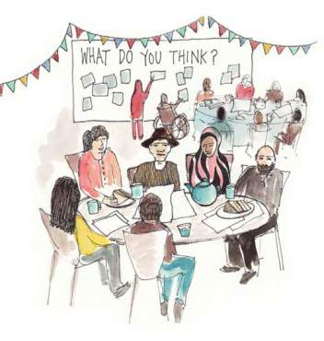
Neighbourhood Plans
What’s it all about?
Brought in by the Coalition Govt in 2011.
Born out of the idea of ‘Localism’, giving local residents a
greater say in development that goes on in their areas
Parish Council owned
  A community-led planning document that will influence
  development in your area over the next 15 or so years

Slide 2
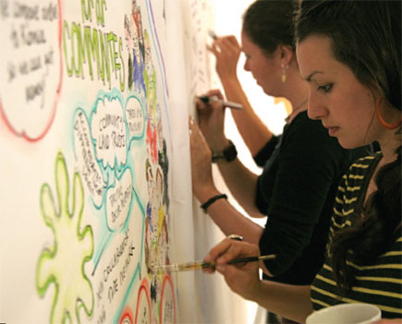
Why do it?
Gives community a voice in decision making.
Once adopted, the policies become part of the development Plan- holds legal weight in decisions.
More focused- Local Plan covers the District
  Establishes a dialogue within the community.
  25 % CIL money for adopted plans

Slide 3
What CAN’T they do?
they cannot be used to stop growth but can help inform, direct and shape development
They cannot propose lower levels of housing/growth than that in the Local Plan.
Can’t have policies on non-land use topics but can identify community priorities. e.g. Setting up car club, promoting public transport needs etc.
Also must comply with:
National Planning Policy Framework
East Devon Local Plan
European Directives/legislation

Slide 4
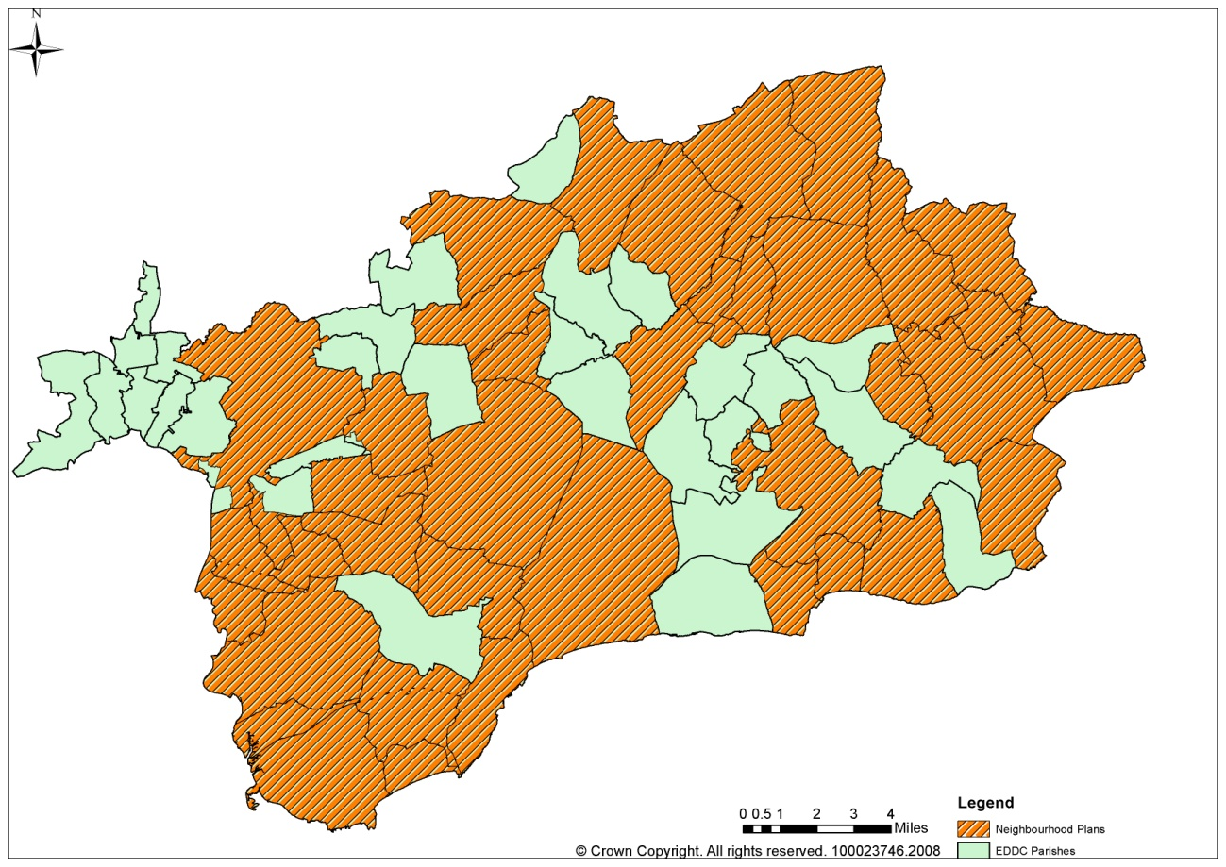
Neighbourhood planning in East Devon
  40 Neighbourhood Areas
  3 Submissions- Stockland, Bishops Clyst, East Budleigh
  1 adopted Plan- Lympstone

Slide 5
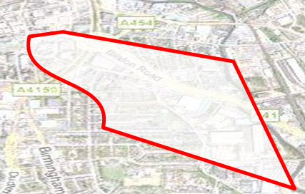
What’s the process?
Stage 1- Designating the Neighbourhood Area
  Parish Council has to decide the appropriate area for the Neighbourhood Plan to cover
  In rural areas a presumption that this will follow the parish boundary.
  Fill out application form on website
  Submit to EDDC
  Area designated!
  Once designated can claim up to £9,000 funding

Slide 6

What’s the process?
Stage 2- Establishing a steering group
  Comprises Town/Parish councillors and members of the public.
  Representative of community.
  Meets regularly and drives forward progress of plan.
  Developing and monitoring the project plan

Slide 7
What’s the process?
Stage 3- Reviewing and gathering evidence
  Creating a parish profile- analysing demographic data, population size, historical development etc
  Reviewing existing information related to area, e.g. Open space studies, SHLAA data- East Devon District Council can help with this!
  As process continues this will be added to as views are sought from the community.

Slide 8
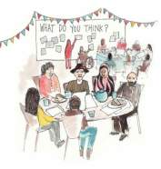
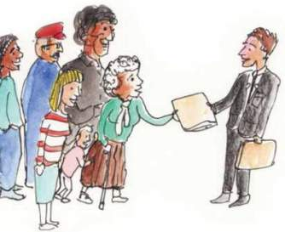
What’s the process?
Stage 4- Consulting the community
  Getting community views to assess aspirations
  Could include questionnaires, workshops, flyers, information on websites, exhibitions etc.

Slide 9

What’s the process?
Stage 5- Developing aims and objectives
  Analysing the data from evidence gathering and consultation steps to produce overarching aims of what the plan is to achieve.
  Expressed in a series of statements. e.g. Ensuring new development is suitably designed, encouraging tree planting schemes, protecting particular open spaces etc.
  Should go through another stage of consultation to ensure the community supports them.

Slide 10

What’s the process?
Stage 6- Drafting the plan
  Pulling together all of the information from the previous stages.
  Producing planning policies to support the aims and objectives
  Very important as these are what planning applications will be judged against!

Slide 11
What’s the process?
Stage 7- Submission to Local Authority
  Submit to East Devon who will check to ensure the necessary legal steps have been followed and it is in conformity with local and national policy.
  Local Authority will then publicise the plan and consult with any interested parties.

Slide 12
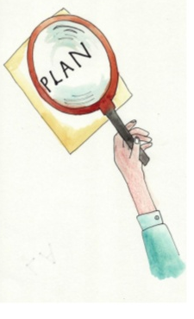
What’s the process?
Stage 8- Examination
  Local Authority will then appoint independent
  planning professional to examine the contents.
  He/she will check that the plan has met the basic
  conditions.
  Paid for by Local Authority
  He will produce a report suggesting amendments and either suggesting that the plan should or should not proceed to referendum.

Slide 13

What’s the process?
Stage 9- Referendum
  If successful examination, then Local Authority will organise referendum for the plan.
  If greater than 50% in favour of Plan-
  Plan Adopted!
  Approximately 2 years from start to finish.

Slide 14
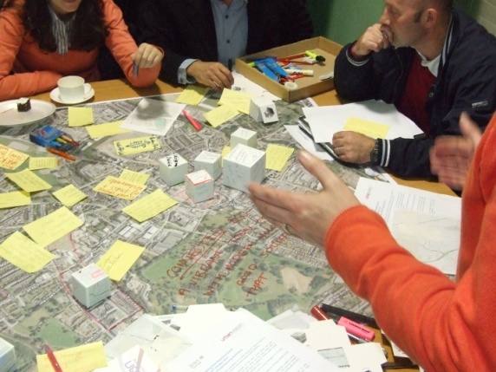
  How East Devon is helping NP groups
  Producing bespoke guidance notes at various stages of the process on website (collecting evidence, engaging the community).
  Creating document templates including basic conditions statement, consultation statement, project plan.
  Dedicated officer always being available to offer advice to groups.
    Can produce maps
    Help write policies
    Feedback on questionnaires
    Attending steering group sessions.
  Regular Newsletters.
  Advising on any national updates.

